Slide 1

IS Operations & Business Resilience
Information Systems Auditing
Class IX

Slide 2
Class Recap

Slide 3
Class Roadmap
IT Governance: Concept
IT Governance: Audit Program
IS Acquisition and Development
IS Implementation
Practicum on Domain 3
Navigating International Standards (GTAG)
Mid-Term Exam Prep
Mid-Term Exam
IS Operation & Business Resilience I
IS Operation & Business Resilience II
Protection of Information Assets I
Protection of Information Assets II
Intro to SQL for Auditing
Case Study: Auditing with SQL
Final Exam Prep
Final Exam

Slide 4
Your Mid-Term Score
The Average score is:
86.68
I could make a mistake, so please ask away if my assessment does not feel right for you

Slide 5
Overview Domain 4
IS Operations:
Common Technology Components
IT Asset Management
Job Scheduling and Production Process Automation
System Interfaces
End-User Computing
Data Governance
System Performance Management
Problem and Incident Management
Change, Configuration, Release, and Patch Management
IT Service Level Management
Database Management

Slide 6
Intro

Slide 7
What is it about?
This chapter explains how an organization keeps its IT running every day and how it continues running when things go wrong.
In simple terms:
IS Operations = keeping the lights on
Business Resilience = making sure the lights come back on if they ever go out
CISA wants us to understand two big ideas:
Operations must be controlled so systems run correctly and reliably.
The business must stay alive even when disrupted—disaster, outage, or failure.

Slide 8
Why It Matters
This chapter connects with last topic on risk & control:
If operational controls are weak, operational risks increase.
If resilience planning is weak, downtime becomes catastrophic.

Slide 9
Normal Conditions → “Daily Life”
How IT works day-to-day:
Processing jobs
Managing data
Handling incidents
Making changes safely
Keeping systems available
Analogy:
the “daily kitchen routine”—everything must be organized, controlled, and consistent to produce the same quality every day.

Slide 10
Abnormal Conditions → “Emergency Mode”
How the organization survives disruptions:
Disaster recovery
Backup & restore
Continuity planning
Crisis management
Analogy:
the “emergency plan” when the kitchen catches fire but the restaurant still needs to serve customers.

Slide 11
Auditor’s Concern
IS auditors must know:
which controls should exist in operations
how incidents and changes should be managed
what backup and restore evidence looks like
how to assess BCP/DRP completeness
whether recovery strategies meet business needs

Slide 12
IS Operations In A Nutshell
#goingWell

Slide 13
Focus Areas
Data Input
Processing
Output
Job scheduling & workload
Incident & problem management
Change & configuration management

Slide 14
Input Controls (Before Processing)
Ensure only valid, authorized, complete data enters the system.
Types of controls:
Validation rules (format, range, completeness)
Edit checks (check digits, matching fields)
Authorization for batch uploads
Pre-numbered forms
Online field checks
Why auditors care:
Bad input = bad output, regardless of how perfect the system is.

Slide 15
Output Controls (After Processing)
Ensure output is accurate, delivered correctly, and protected.
CISA-related controls:
Distribution lists
Secure report access
Reconciliation to input
Review by authorized users
Logging who received what
Why auditors care: A perfect process still fails if output goes to the wrong person or is misunderstood.

Slide 16
Job Scheduling & Workload Management
Ensure all IT jobs run in the correct sequence, on time, and without resource conflict.
CISA areas to cover:
Scheduling tools
Prioritizing critical jobs
Managing dependencies
Monitoring failed jobs
Documented restart procedures
Capacity & performance oversight
Analogy:
Like airport runway scheduling—wrong order causes delays everywhere.
Auditor focus:
Evidence of monitoring
Logs of failed/restarted jobs
Proper handling of peak workload

Slide 17
Incident Management
Ensure changes are controlled, tested, approved, and traceable.
CISA-required components:
Change request form
Impact analysis
Testing in non-prod
Approval workflow
Scheduling in maintenance window
Backout/rollback plan
Documentation
Segregation of duties (developer ≠ deployer)
Auditor focus:
Check sample changes for:
Approval
test evidence
Logs
SoD.

Slide 18
Configuration Management
Keep track of what exists in the environment (systems, versions, hardware).
CISA elements:
CMDB (Configuration Management Database)
Baseline configurations
Version control
Patch levels
Hardware/software inventories
Mapping dependencies between components
Analogy:
CMDB = the inventory list of an entire IT “warehouse”.
Auditor focus:
Compare CMDB vs actual environment → identify mismatches.

Slide 19
Topics Covered in CISA Review Manual
Common Technology Components
IT Asset Management
Job Scheduling and Production Process Automation
System Interfaces
End-User Computing
Data Governance
System Performance Management
Problem and Incident Management
Change, Configuration, Release, and Patch Management
IT Service Level Management
Database Management

Slide 20
Common Technology Components

Slide 21
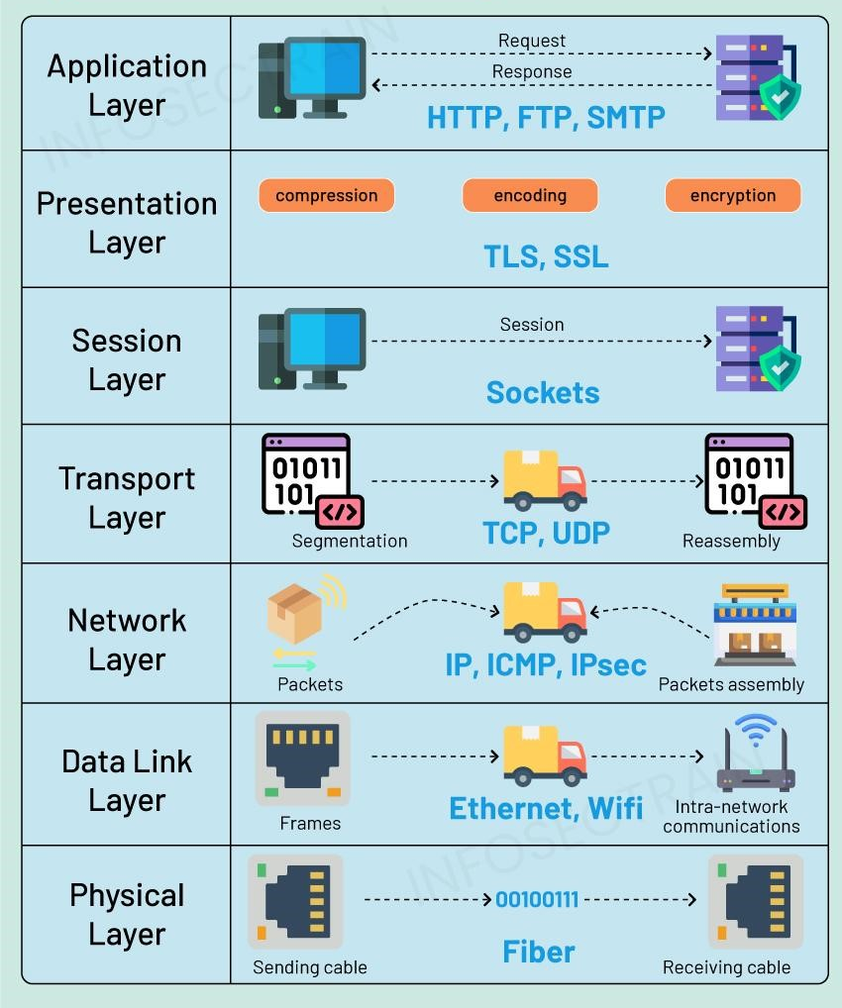
Open Systems Interconnection (OSI) Model
7
Accesses protocols used by applications to communicate data to end users
What and why
The OSI model divides network communication into seven layers so that a complex process can understood, standardized, and troubleshot one function at a time.
6
Configures data into an acceptable format via translation, encryption, and compression
5
Manages connections and the opening and closing of sessions between devices
4
Handles data transmission between devices using UDP and TCP protocols
Why it matters for IS auditing
3
Conducts routing between different networks, determining the most efficient path
It helps auditors determine where to inspect and what evidence to request, for example, physical access controls, firewall rules, IP configurations, encrypted sessions, or application logs.
2
Handles node-to-node data transfer between devices on the same network
1
Converts data into bits to carry it across physical network equipment

Slide 22
Hardware Components & Maintenance
Processing Components
CPU: The "brain," containing the Arithmetic Logic Unit (ALU) and Control Unit.
Memory: RAM (volatile, for active processing) and ROM (non-volatile, for startup).
Storage: HDD (mechanical spinning disks) vs. SSD (flash memory, faster, more durable).
Hardware Maintenance Program:
A formal program to document and perform routine maintenance according to vendor specifications.
Also covers environmental hardware (power, cooling, fire suppression).
Auditor’s Role:
Verify a formal maintenance plan exists and is being followed.
Review hardware monitoring reports (availability, error, utilization) to detect problems and predict future needs.

Slide 23
Risk & Control Example: USB Mass Storage Devices
Key Risks:
Malware: A common vector for viruses and spyware.
Data Theft: Easy for unauthorized individuals to copy large amounts of data from an unattended PC.
Data and Media Loss: High risk of loss due to small size, leading to confidentiality breaches if not encrypted.
Key Controls:
Encryption: Render data useless without the required key or password.
Granular Control Software: Block or manage USB ports centrally (e.g., allow keyboards but block storage devices).
Policy & Awareness: Enforce antivirus scanning of removable media and use of locked desktop policies.

Slide 24
IT Asset Management

Slide 25
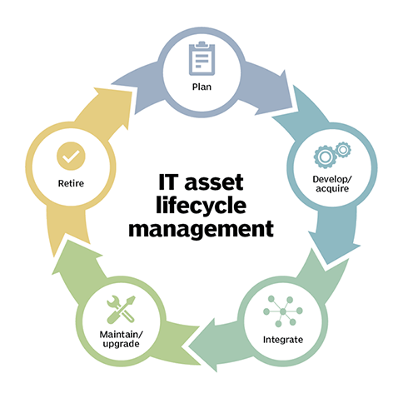
IT Asset Management
The process of ensuring an organization's assets are accounted for, deployed, maintained, and disposed of when no longer needed.
The Process:
Identify all IT assets (hardware, software, data).
Create and maintain an inventory of all assets.
Track the asset throughout its life cycle.
Key Inventory Fields:
Owner & Custodian
Location
Security/Risk Classification
Compliance Requirements
You can’t protect what you don’t know you have!
Auditor's Role: To verify that a complete and accurate inventory of all IT assets exists and is actively maintained.

Slide 26
Job Scheduling & Automation

Slide 27
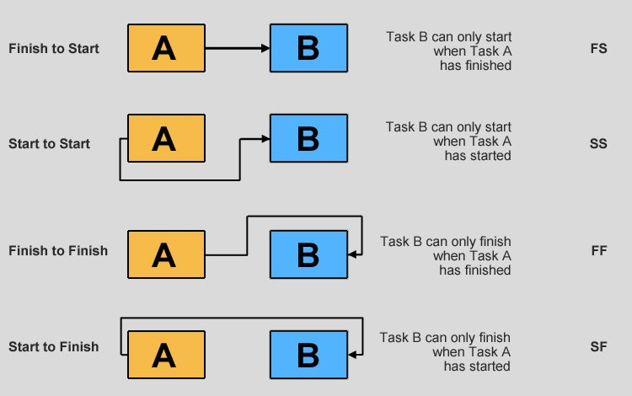
Job Scheduling and Automation
A list of batch jobs that must be run, their execution order, and any dependencies
Key Controls:
High-priority jobs are given optimal resource availability.
Maintenance functions (e.g., backups) are performed during non-peak times.
Logs are maintained of all job successes and failures.
Auditor's Role:
Review the job schedule to ensure it aligns with business priorities and review console logs for evidence of job failures and timely resolution

Slide 28
System Interfaces

Slide 29
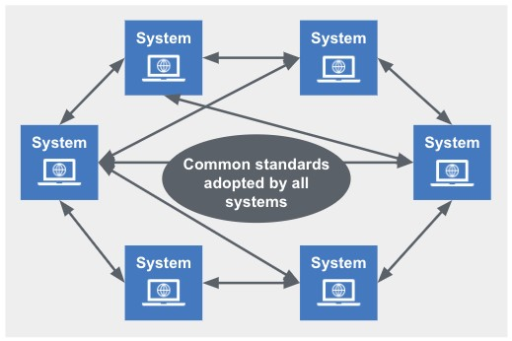
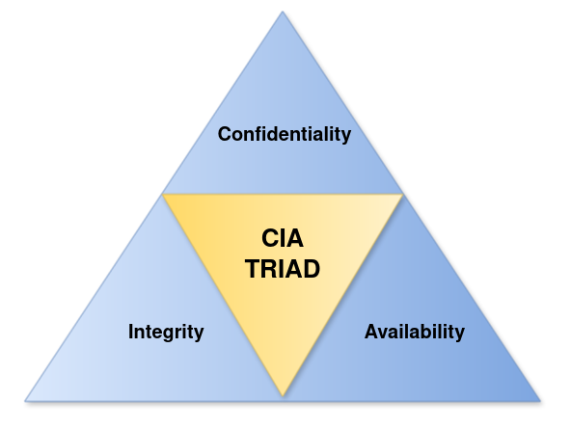
System Interfaces
The connections that allow data to be exchanged between different systems, both internally and with external partners.
The Process:
Data Integrity: Data is corrupted or lost during transfer.
Data Confidentiality: Unauthorized access to data in transit.
Data Availability: System outages cause incomplete data transfers.
Key Inventory Fields:
Reconciliation: Using control totals or cryptographic hash checksums to verify that data sent equals data received.
Encryption: Protecting data during transfer, especially across untrusted networks.
Audit Trails: Logging all interface activity (who sent what, when it was sent, when it was received)

Slide 30
End-User Computing (EUC)

Slide 31
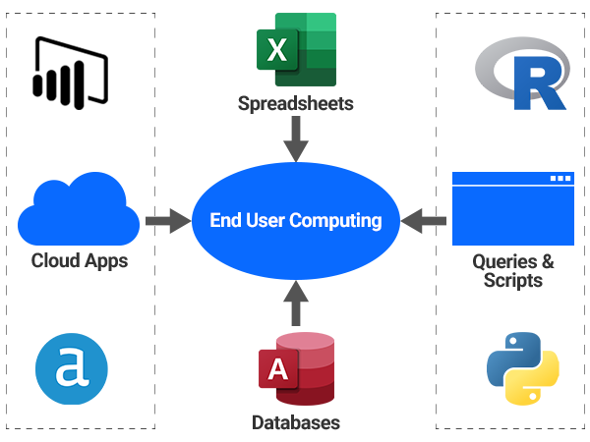
End-User Computing and Shadow IT
End-User Computing
The ability of non-IT professionals to design and implement their own applications (e.g., complex spreadsheets, Access databases)
Shadow IT
The use of systems, services, or software without explicit approval from the IT department (e.g., using a personal cloud storage account for work files)
Key Risks:
Lack of security controls (no authorization, logging, or encryption).
Data loss (applications are not properly backed up).
Compliance violations (sensitive data stored in unapproved locations)
Auditor's Role: Evaluate the organization's policies and compensating controls for managing these risks.

Slide 32
Data Governance

Slide 33
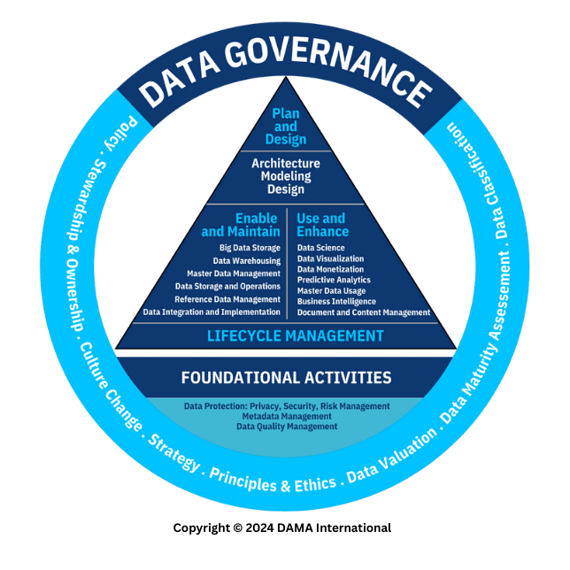
Data Governance
The overall management of the availability, usability, integrity, and security of data used in an enterprise
Key Principles for IS Operations:
Ownership: Data owners must be assigned for critical information assets.
Classification: Assets must be classified based on sensitivity to apply appropriate controls.
Integrity: Controls must ensure data accuracy and completeness, especially in system interfaces and databases (e.g., referential integrity).
Security: Access controls, encryption, and logging must be implemented based on data classification.
Auditor's Role: Verify that a data governance framework is in place and that operational
processes (asset management, database administration, etc.) adhere to it

Slide 34
Systems Performance Management

Slide 35
Goal of System Performance Management
To ensure that IS architecture, software, and resources can efficiently meet current and future business demand.
Key Areas:
Operating Systems Management
Ensuring the core software that runs the computer is secure and properly configured.
Software & Source Code Management
Controlling software licenses and the underlying code of applications.
Capacity Management
Planning and monitoring computing resources (CPU, storage, network) to ensure they are sufficient

Slide 36
Operating Systems Fundamentals
Role of the OS: Interfaces between the user, processor, and
application software. Manages all computer resources.
Key Concept:
Nucleus (Kernel): The core of the OS. A highly privileged area where most user access is restricted
System Generation (SYSGEN): The process of customizing an OS at installation time by setting key parameters.
Registry (Windows): A database of critical system configuration files and options.
Auditor's Role:
Review system configuration files and parameters to ensure that control options protecting the OS's supervisory state are properly configured and secured from unauthorized changes.

Slide 37
Software Licensing & Source Code Management
Software Licensing
A contract establishing the terms under which software
can be legally used
Auditor's Role:
Compare software license agreements with software inventory scans to identify and report any violations (unlicensed use).
Source Code Management:
The process of managing and protecting the human-readable
code that makes up an application.
Version Control System (VCS): Software (like Git) that tracks all changes to source code, controls access, and allows rollback to previous versions.
Source Code Escrow: An agreement to store the source code with a trusted third party, to be released if the vendor goes out of business

Slide 38
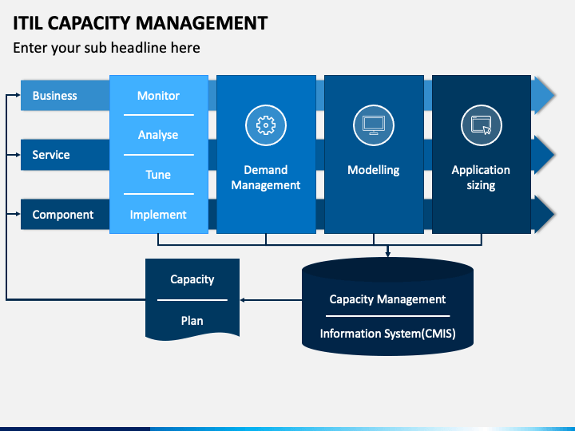
Capacity Management
The process of planning and monitoring computing
resources to ensure they meet business demand efficiently.
The Process:
Monitor key metrics (CPU, storage, bandwidth utilization).
Analyze trends to establish a baseline and forecast future needs.
Tune systems for optimization. (stretch resources further)
Implement new capacity before performance is impacted.
Auditor's Role:
To review the capacity plan and verify that it is based on business input,
considers future growth, and is updated at least annually.

Slide 39
Problem and Incident Management

Slide 40
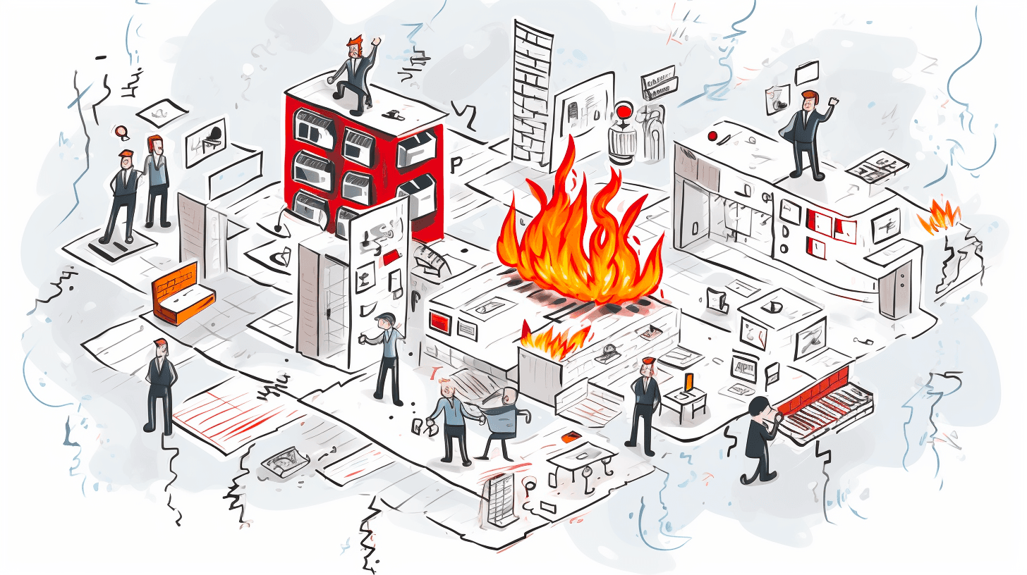
Incident vs. Problem Management
Incident Management
(Reactive)
Goal: Restore normal service operation as quickly as possible.
Focus: Minimizing the immediate business impact of a disruption.
It is the "fire department” fighting the fire
Problem Management
(Proactive)
Goal: Identify the root cause of one or more incidents to prevent them from recurring.
Focus: Root cause analysis (e.g., 5 Whys, Fishbone diagrams) and creating a Known Error Database (KEDB).
It is the "fire inspector” identifying cause of the fire

Slide 41
Change, Configuration, Release, and Patch Management

Slide 42
Change, Config, Release & Patch Management
Change Management
The overarching process to ensure that changes are made efficiently and with minimum disruption to services
Configuration Management
The process of identifying, controlling, and tracking all versions of hardware, software, and documentation.
Release Management
The process of planning, scheduling, and controlling a software build through different stages into production.
Patch Management
A subset of change management focused on acquiring, testing, and installing code changes (patches) to address security vulnerabilities.

Slide 43
The Change & Release Process
Types of Releases:
Major: Significant new functionality.
Minor: Small enhancements and fixes.
Emergency: Urgent fixes to prevent significant business impact.
These often bypass some testing, increasing risk.
Key Controls:
Formal (documented) request, authorization, testing, and implementation procedures.
Segregation of duties between development, testing, and production environments
CRITICAL CONTROL: A documented and tested rollback plan must exist to restore the system to its previous state if a release fails
Auditor's Role:
Verify that formal change control procedures exist, are documented, and are followed for all types of changes.

Slide 44
IT Service Level Management

Slide 45
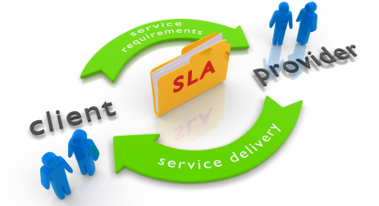
IT Service Level Management
IT Service Management (ITSM)
A process-based approach to managing IT as a service to the business, often guided by frameworks like ITIL.
Service Level Agreement (SLA)
A formal agreement between an IT service provider and a customer (the business) detailing the services to be provided.
Key Component of SLA:
Describes services in non-technical, business-focused terms.
Defines specific, measurable service levels.
Includes penalties for non-performance
(e.g., 99.9% uptime)
An organization can outsource the responsibility for service delivery, but it cannot outsource the accountability for protecting its data and providing service to its customers.

Slide 46
Database Management

Slide 47
Database Fundamentals & Structures
Database Management System (DBMS)
Software that organizes, controls, and provides access to data
(e.g., Oracle, MSFT SQL Server)
Database Structures:
Relational (RDBMS): The most common model. Organizes data in tables with rows and columns.
Hierarchical/Network: Older, tree-like or web-like structures.
Object-Oriented (OODBMS): Stores data as objects; useful for complex data types.
NoSQL: "Not only SQL." Designed for large volumes of unstructured data ("big data")

Slide 48
Key Database Controls
Access Controls
Strictly limit access to data based on the principle of least privilege.
Pay special attention to privileged users like the Database Administrator (DBA), who often has god-like powers over the database.
Integrity Controls
Referential Integrity ensures that relationships between tables are maintained.
EXAMPLE: you can't create an order for a customer that doesn’t in the customer table
Concurrency Controls
Manages simultaneous updates using techniques like record locking to prevent two users from changing the same piece of data at the same time.
Audit and Logging
Database activity monitoring (DAM) should be enabled, and logs should be
reviewed regularly. Logs are made valuable through review

